Slide 1
Million Song Dataset Classification by Genre
Krunal Khatri

Slide 2
What is Million Song Dataset
The Million Song Dataset is a freely-available collection of audio features and metadata for a million contemporary popular music tracks.
Initial Contribution to the dataset was done by The Echo Nest (now owned by Spotify)
Since its inception various other services like SecondHandSongs.com, musiXmatch.com, last.fm and other have contributed to this dataset.
The dataset in its entirety is 280Gb and one of the services that has this whole dataset is Amazon Web Services.
Some Features are algorithmically generated and some are raw data.
Most of these original and additional metadata are on the website:
<http://labrosa.ee.columbia.edu/millionsong/>

Slide 3
How to use the data
The original full featured dataset is hard to get.
But metadata has been made available by downloads and API access.
These metadata files are in various formats and range from 2.7Gb to 200Mb and all these are TEXT files.
File formats that are available are from HDF5, SQLite, csv and tab separated.
One of the main challenge is to work with this data without seeing it in its entirety.
So, one of the best ways to work with this data is to combine it in a structured manner.

Slide 4
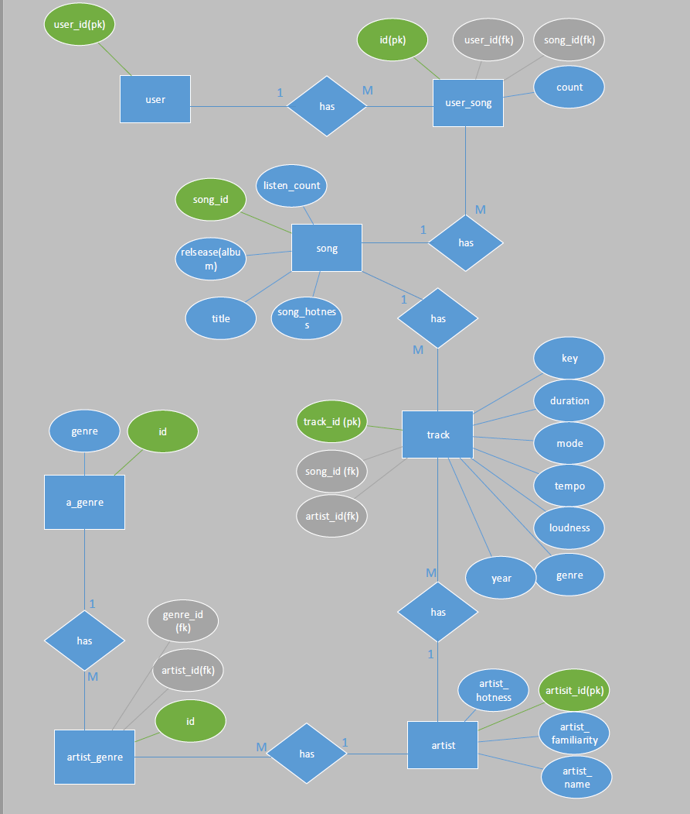
Database is the best way to structure random data
I used python and the built in sqlite3 module to build this database.
It is a fully normalized database design.
The next challenge was to populate this database
Writing an efficient program to quickly populate.

Slide 5
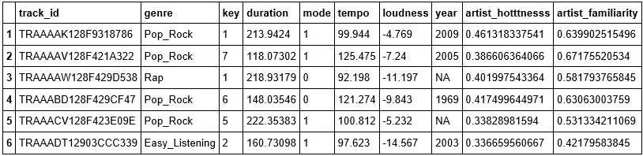

What is the data like
Variable Selection:
Still an apparent problem: Missing Values
Its only about 3.75%. Still its only the beginning.
Missing Values

Slide 6
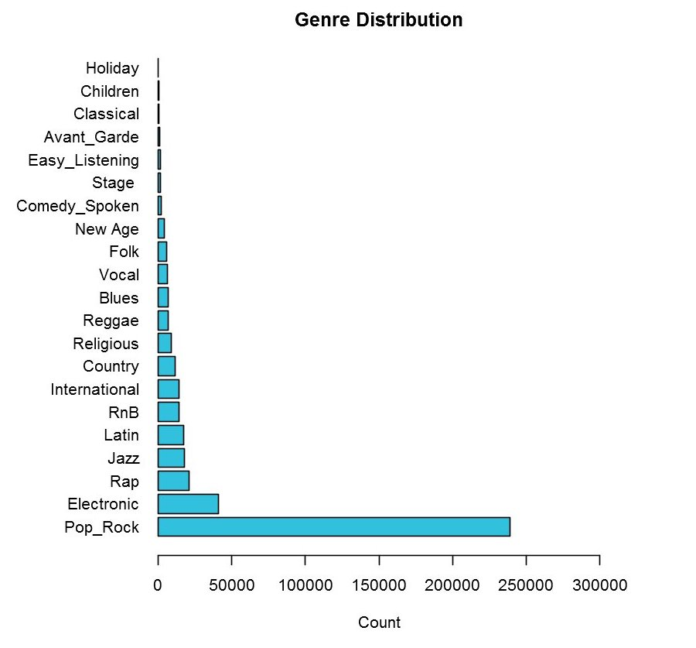
Target Class

Slide 7
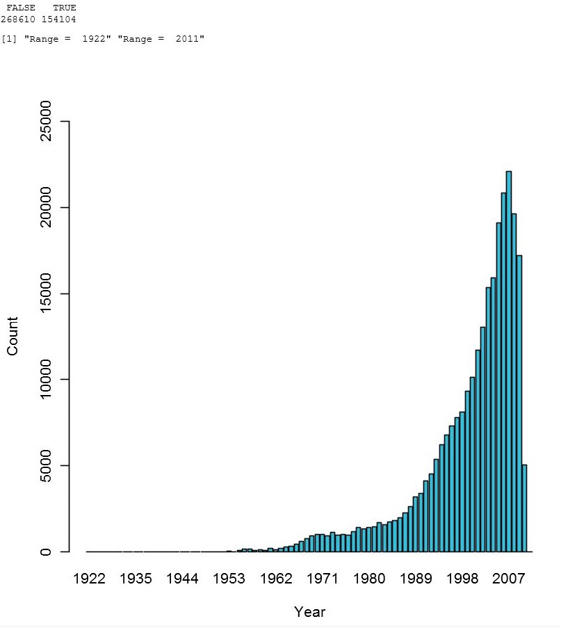
Missing Values

Slide 8
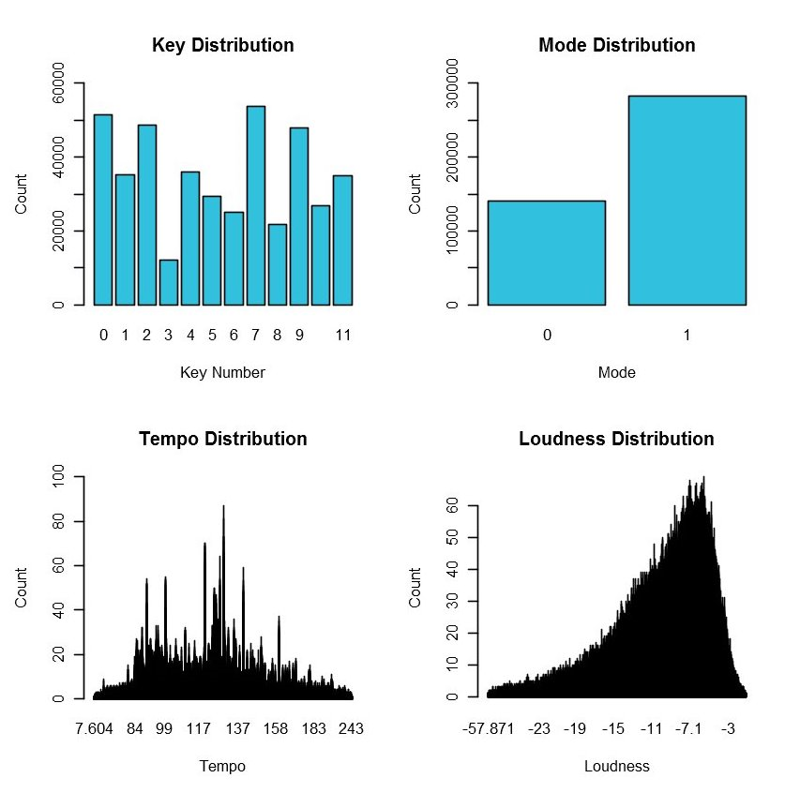
Range: 0 to 11
Range: 0 and 1
Range: 0 to 281
Range: -57.8 to 4.3

Slide 9
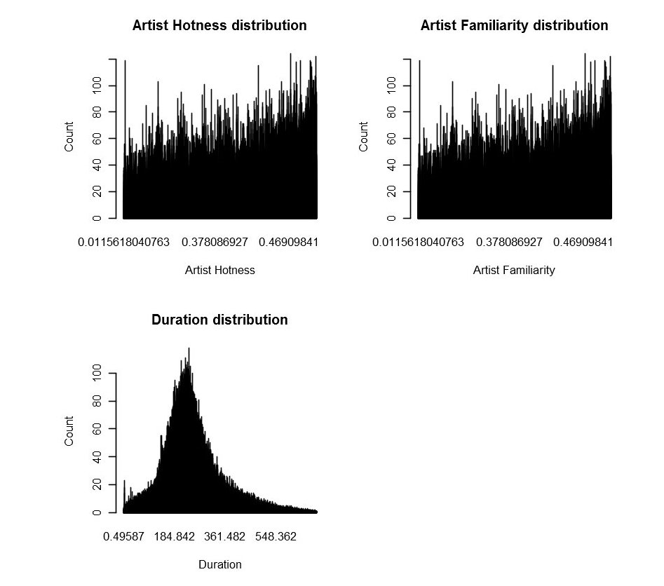


Range: 0 to 1.08
Range: 0 to 1
Missing Values
Missing Values
Range: 0.50 to 3034 seconds

Slide 10
Cleaning the data
Variable year had maximum number of missing values: 154000 out of 268000.
So the this variable had to go.
Relatively less missing values of 9 and 14 for artist_hotness and artist_familiarity were filled in with the median values.
Another problem was the large discrepancy in songs for each genre.
Pop Rock being the genre with most songs. (238736)
Holiday being he genre with the least songs. (200)
So, I decided to split the data, one with songs having less than 10k songs and one with having more than 10k songs.

Slide 11
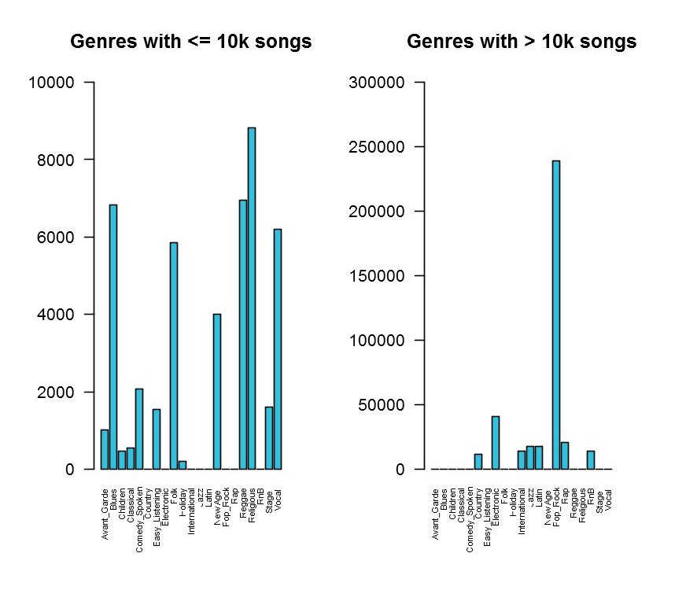
Still the data does not look balanced at all.
The Classification tree will be biased with this data.
So I removed the genres with less than 1k songs from the less frequent dataset. (Left)
For the more frequent dataset (Right), there are two major outliers, Pop Rock and Electronic.
So I randomly removed excess data to the third highest frequent data (Rap).

Slide 12
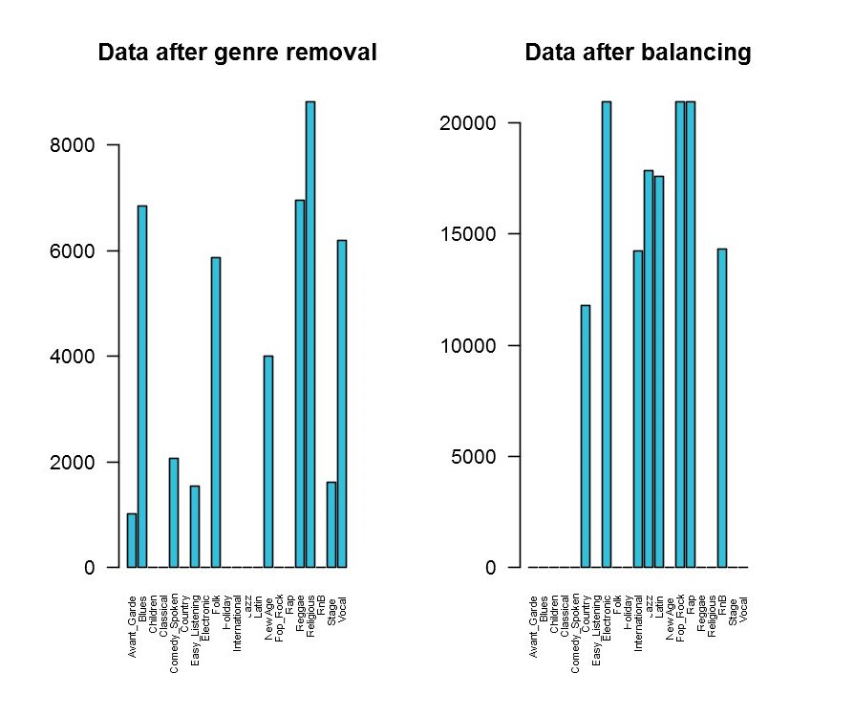
The less frequent data (left) still looks unbalanced but some have got close neighbors.
44906 rows of data.
The more frequent data (right) looks well balanced.

Slide 13
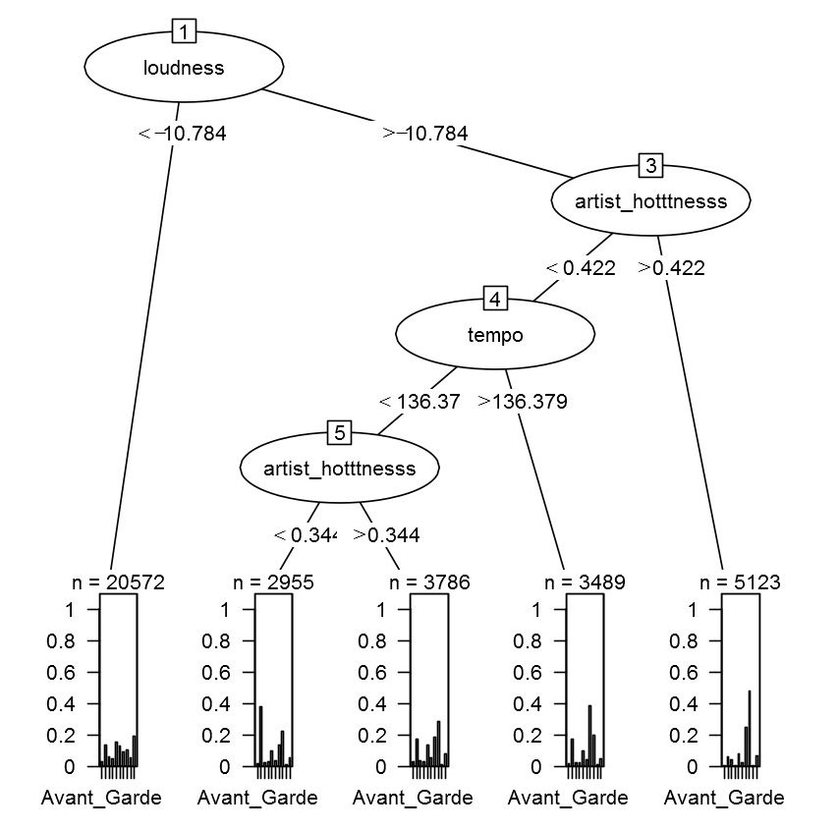
Full Tree (Less Frequent Dataset)
Error Rate on Training Data:
0.7227557
Error Rate on Test Set:
0.7209665

Slide 14
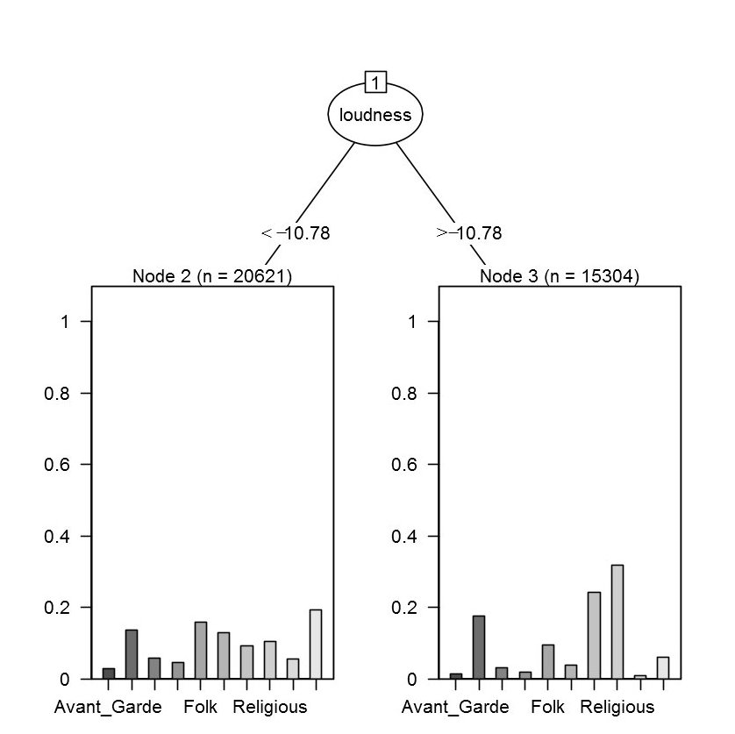
Pruned Tree:
Misclassification rate:
Training Data: 0.7534
Testing Data: 0.7516
This is even worse than a random guess.

Slide 15
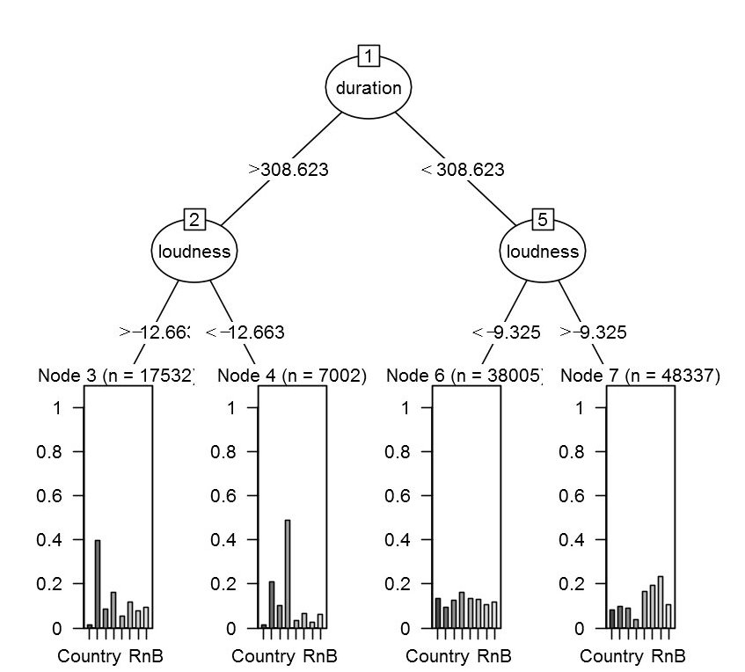
Full tree with the more frequent dataset.
Amazingly, misclassification rate on the test and training data = 0.75
Even with 138594 rows of data and only 8 genres. The classification rate is not good enough.
Cp for the full tree with three splits is 0.01
Cp for a tree with two splits is 0.02.

Slide 16
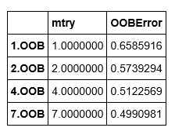
Tune Random Forest ( full model ) Mtry is the number of variables to choose at level independently and at random out of all M possible variables Find the best split from the randomly selected M variables and fully grow the tree.

Slide 17
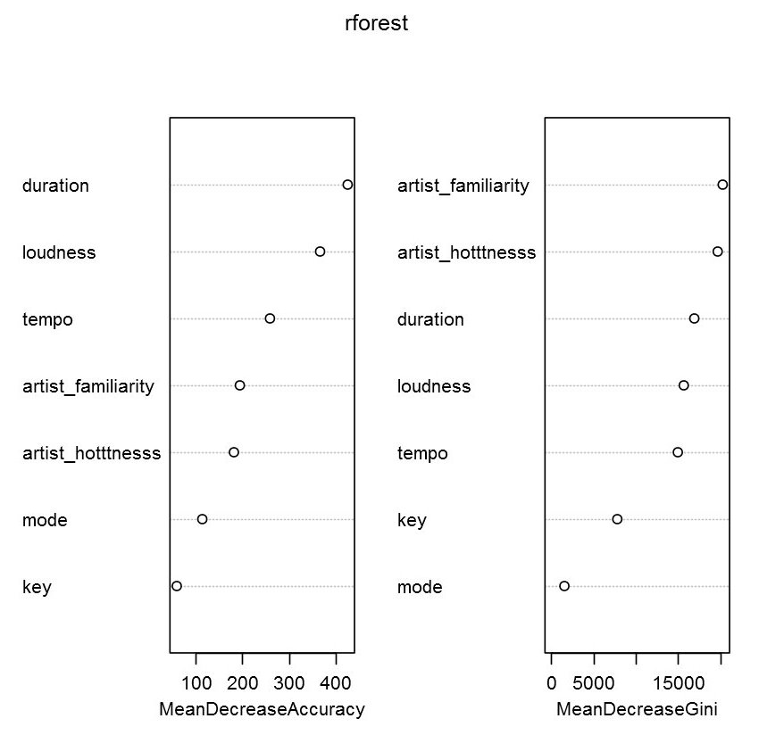
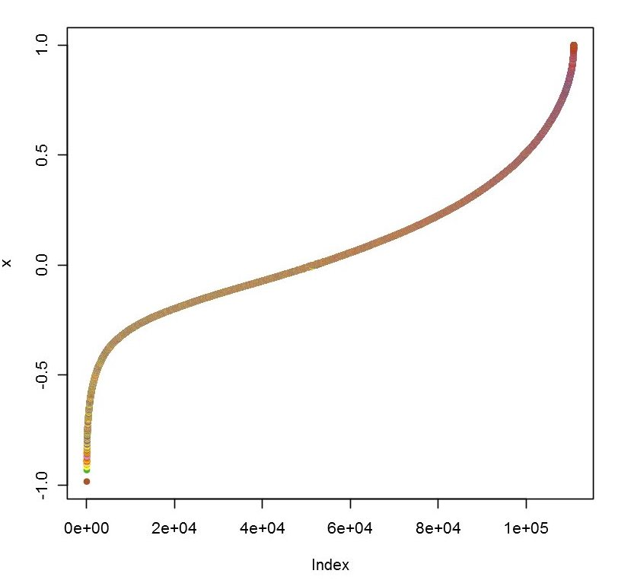
Random Forest (full model, 500 trees) Misclassification = 0.457

Slide 18
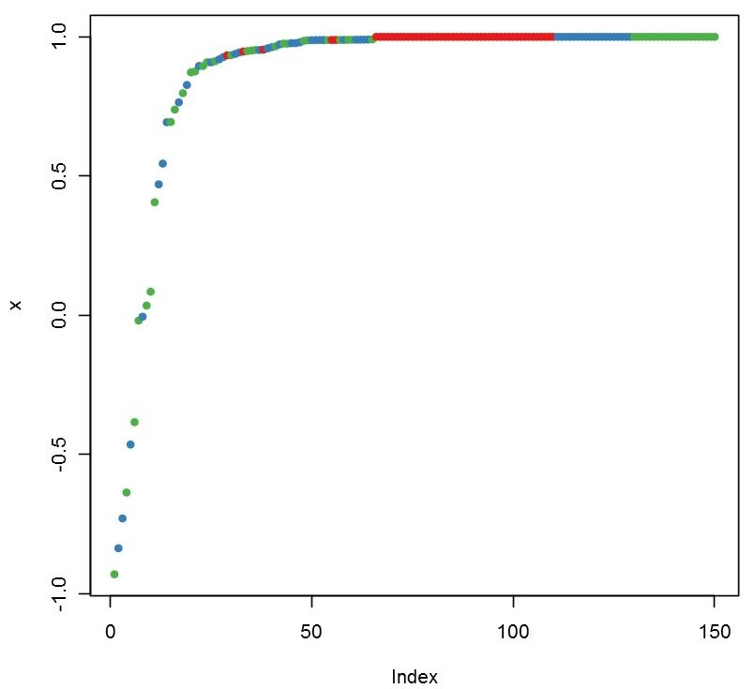
Ideal Margin (only for classification trees)
Margin is the proportion of votes for the correct class minus maximum proportion of votes for the other classes.
Positive margin means correct classification.
Margin plot using the Iris dataset fitted with 500 trees.

Slide 19
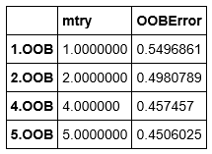
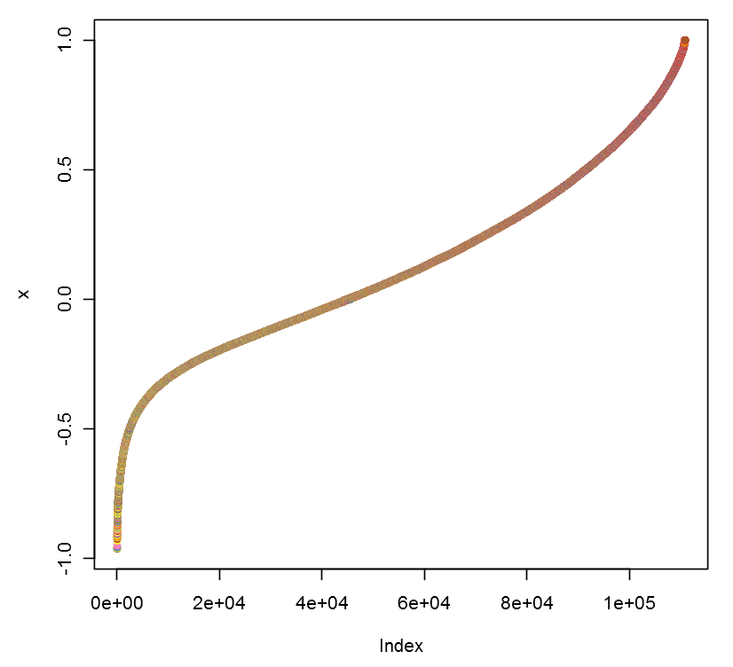
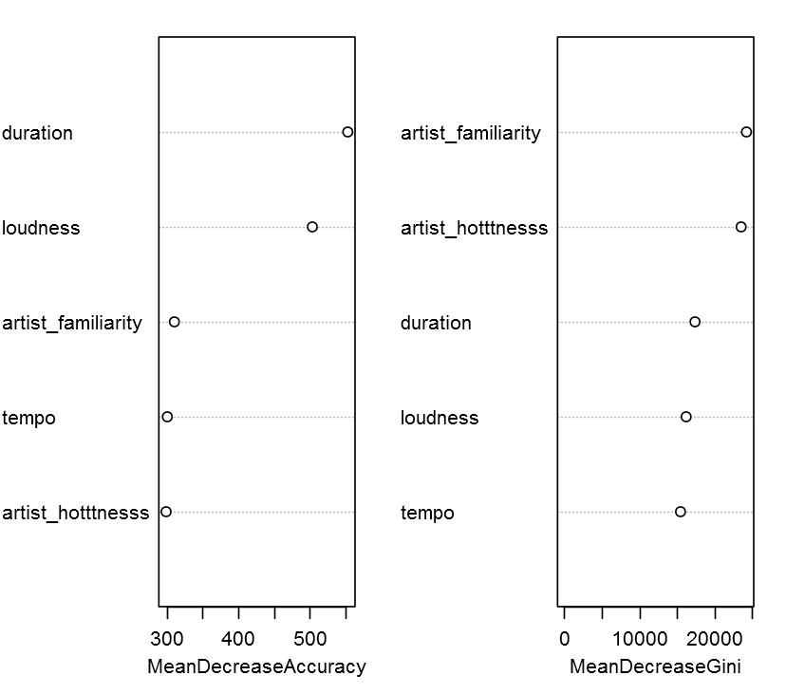
Random Forest Reduced Model Misclassification = 0.398

Slide 20
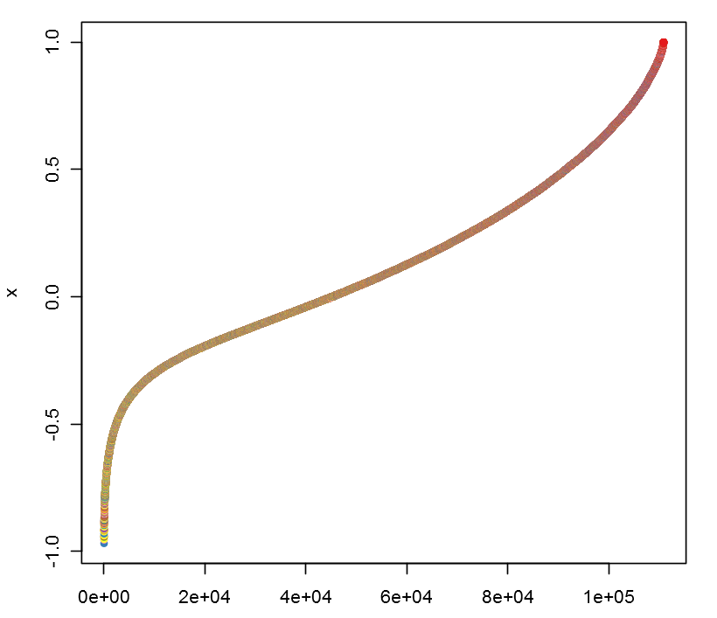
Random Forest (1000 trees) Misclassification Rate = 0.40

Slide 21
Summary
Less popular Genre:
Classification tree:
Full tree Misclassification Rate: 0.721
Pruned Tree Misclassification Rate: 0.7516
More Popular Genre:
Classification tree:
Full tree Misclassification Rate: 0.75
Random Forest:
Full Model 500 trees Misclassification Rate : 0.457
Full Model 1000 trees Misclassification Rate : 0.460
Reduced Model 500 trees Misclassification Rate: 0.398
Reduced Model 1000 trees Misclassification Rate : 0.40

Slide 22
Conclusion
low accuracy using Simple Models:
Although there was plenty of data, classification trees used only the variables that the algorithm deemed were most important.
RELATIVELY high accuracy using ensemble method
These complex methods significantly improve prediction but in effect cannot be concluded as being better because their accuracy is still only a little better than random guess.
Future work will include implementing neural network, and getting data with more important variables like song popularity and song hotness.
Thank You

